Slide 1
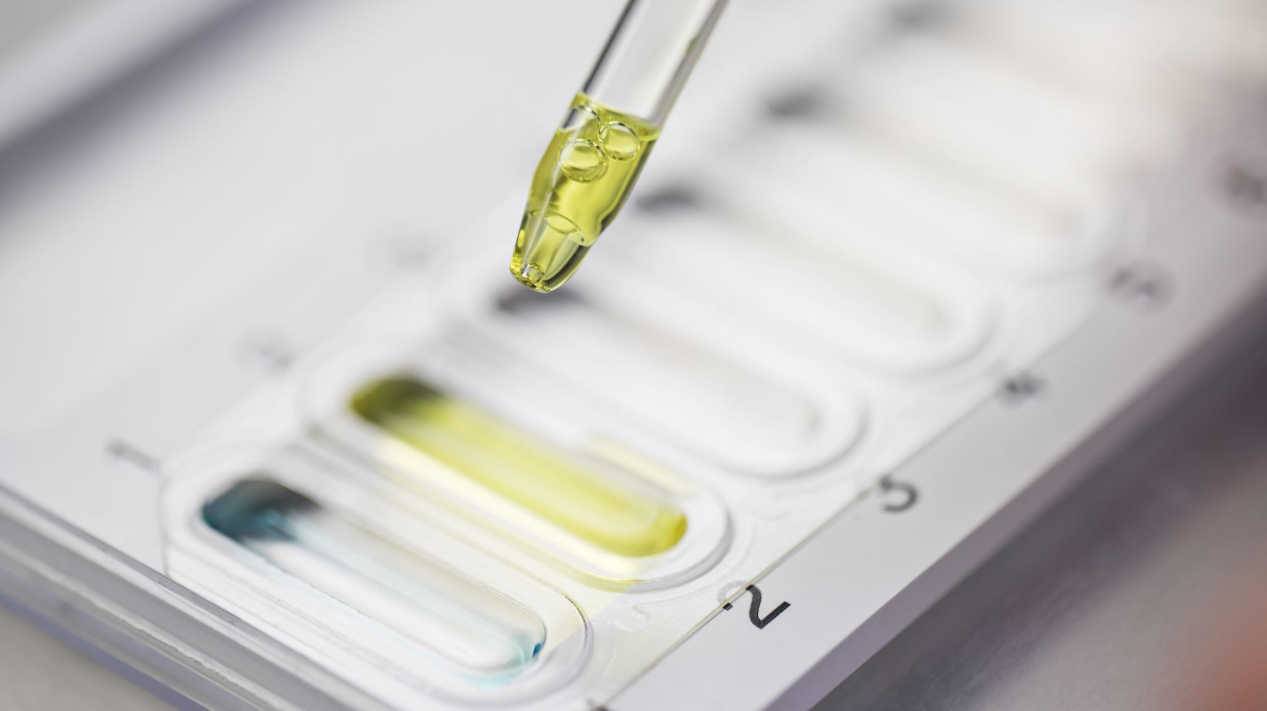
Statistical Analysis
Data 205
David Williams

Slide 2

Determining Graduation Rate
The question is to determine the factors that influence a graduation rate
SAT Scores - Does student with higher SAT scores have a higher graduation rate?
Tuition Cost – Is the cost of Tuition a factor in graduation?
Faculty Salary – Could the quality of the teachers measured by their salary be a factor in graduation?

Slide 3
Determining Graduation Rate
Hypothesis
H0 – The SAT score do not affect the graduation rate
Ha – Student that have a higher SAT score has a higher graduation rate
H0 – The cost of tuition do not affect the graduation rate
Ha – The tuition cost does affect the graduation rate
H0 – The quality of the teacher as measure by their salary do not affect the graduation rate
Ha - The quality of the teacher as measure by their salary do affect the graduation rate

Slide 4
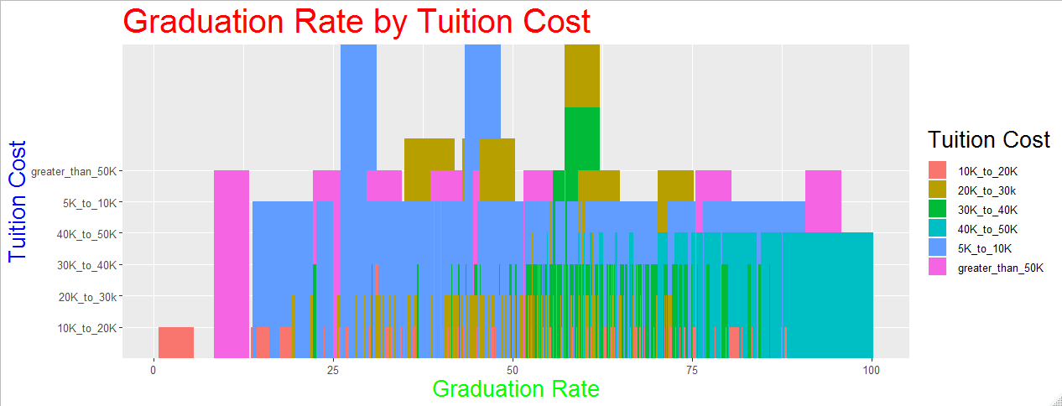
Graduation Rate by Tuition Cost

Slide 5
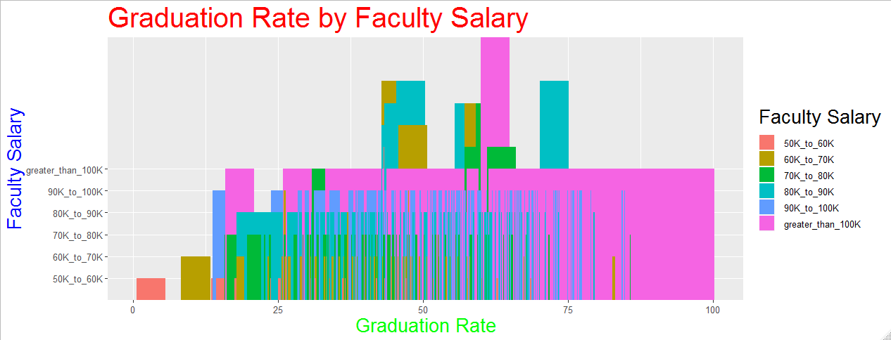
Graduation Rate by Faculty Salary

Slide 6
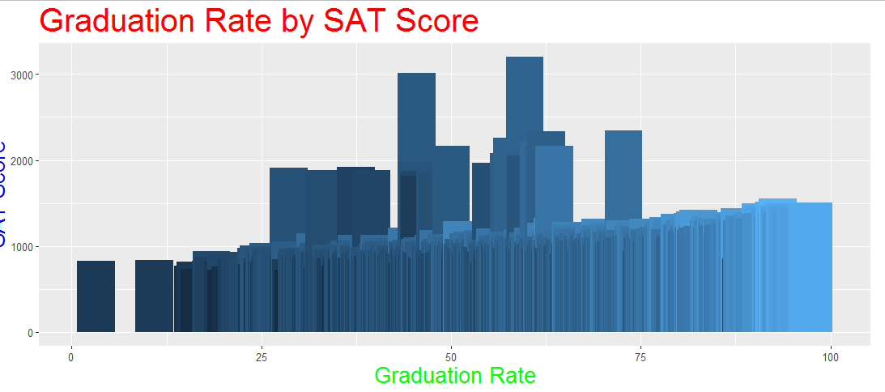
Graduation Rate by SAT Score

Slide 7
Linear Regression
lm(formula = grad_rate_150_p_2013 ~ sticker_price_2013 + salary +
sat_avg_2013, data = training_set)
Coefficients:
Estimate Std. Error t value Pr(>|t|)
(Intercept) -3.871e-01 2.696e-02 -14.357 < 2e-16 ***
sticker_price_2013 2.933e-06 2.818e-07 10.411 < 2e-16 ***
salary 9.207e-07 1.807e-07 5.096 4.36e-07 ***
sat_avg_2013 7.576e-04 3.563e-05 21.264 < 2e-16 ***
---
Signif. codes: 0 '***' 0.001 '**' 0.01 '*' 0.05 '.' 0.1 ' ' 1
Residual standard error: 0.08866 on 772 degrees of freedom
Multiple R-squared: 0.7243, Adjusted R-squared: 0.7232
F-statistic: 676.1 on 3 and 772 DF, p-value: < 2.2e-16

Slide 8
Linear Regression Equation
All three variables has three asterisks and low p-values
Graduation percent = -3.871e-1 + 2.933e-6 * tuition +
9.207e-7 * faculty salary +
7.576e-4 * SAT score

Slide 9
Confidence Interval 95%
Residuals:
Min 1Q Median 3Q Max
-0.30460 -0.06233 0.00230 0.05889 0.44964
Lower 2.5 % Upper 97.5 %
(Intercept) -4.400377e-01 -3.341779e-01
sticker_price_2013 2.380369e-06 3.486585e-06
salary 5.660563e-07 1.275351e-06
sat_avg_2013 6.876493e-04 8.275261e-04

Slide 10
Machine Learning
Actual | 0.261176471 | 0.270522388 | 0.359087778 | 0.448717949 | 0.45751634 | 0.621621622 | 0.625141563 | 0.648584906 | 0.791738382 | 0.907284768
Predicted | 0.433307342 | 0.448003429 | 0.450103683 | 0.461286255 | 0.472199691 | 0.559527065 | 0.589625395 | 0.677484344 | 0.700549955 | 0.87637141
Difference | -0.172130871 | -0.177481041 | -0.091015905 | -0.012568306 | -0.014683351 | 0.062094557 | 0.035516168 | -0.028899438 | 0.091188427 | 0.030913358
Percent Error | 65.91% | 65.61% | 25.35% | 2.80% | 3.21% | -9.99% | -5.68% | 4.46% | -11.52% | -3.41%

Slide 11
Chi-Square Value
0.01967947 = sum(square(predicted grad rate – actual grad rate)) / actual grad rate
Low value indicate good fit

